Slide 1

GUIDELINES FOR LOCATION WRAP November 2016

Slide 2
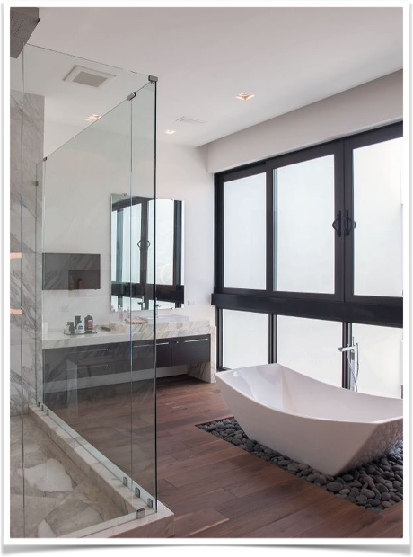
PROCEDURES TO REPLACE OR REPAIR A DAMAGE PROPERTY

Slide 3
LOCATION DEPARTMENT WORKFLOW
INFORM OWNER THAT THERE WILL BE NO REIMBURSEMENT IF THE ITEM IS REPLACED OR REPAIRED WITHOUT ABIDING BY THE COMPANY NOTIFICATION GUIDELINES (AS SET OUT IN THE LOCATION AGREEMENT) AND PRODUCTION APPROVAL.
SUBMIT A REPORT OF DAMAGES VIA EMIAL, INCLUDING A DETAILED LISTING OF PROPERTY DAMAGE AND A PICTURE OF DAMAGES, TO EXECUTIVE PRODUCER, LOCATION MANAGER AND DIRECTOR OF OPERATION.
IF A TELEMUNDO THIRD PARTY VENDOR IS HIRED TO REPAIR THE DAMAGE, THE LOCATION DEPARTMENT MUST CONTACT OUR PRODUCTION COMPLIANCE SPECIALIST, YERESYS ARAGON. THE SCOUT WILL OVERSEE THE VISIT TO THE PROPERTY AND ACQUIRE AN ESTIMATE FROM THE THIRD PARTY VENDOR.
IF THIRD PARTY VENDOR IS HIRED BY THE PROPERTY OWNER TO REPAIR DAMAGES, SUCH VENDOR WILL BE PAID DIRECTLY THROUGH THE OWNER. ONLY UPON TELEMUNDO’S APPROVAL WILL THE THIRD PARTY VENDOR BE PAID DIRECTLY BY TELEMUNDO; IN SUCH CASES, SAID VENDOR MUST PROVIDE REGULATORY INFORMATION THAT COMPLIES WITH COMPANY POLICIES.
IF TELEMUNDO’S IN-HOUSE PERSONNEL REPAIRS THE DAMAGES, THE LOCATION SCOUT MUST SET UP AN APPOINTMENT TO VISIT THE PROPERTY AND OVERSEE THE LABOR.
AFTER PAYMENT HAS BEEN MADE TO THE OWNER, OR AFTER TELEMUNDO HAS REPAIRED THE DAMAGES, OWNER MUST SIGN A WRITTEN RELEASE ACKNOWLEDGING THE DAMAGE HAS BEEN PROPERLY REPAIRED AND RELEASING TELEMUNDO FROM ALL LIABILITY.
THE LOCATION MANAGER WILL LEAD THE PROCESS AND SUPERVISE COMPLIANCE WITH THE ABOVE REQUIREMENTS.

Slide 4
LOCATION - PRODUCTION WORKFLOW
THE REPORT OF DAMAGES, INCLUDING A DETAILED LISTING OF PROPERTY DAMAGE AND A PICTURE OF DAMAGES, IS SUBMITTED TO THE EXECUTIVE PRODUCER, LOCATION MANAGER, AND DIRECTOR OF OPERATION OR ANY OTHER DEPARTMENT THAT HAS A CORRELATION WITH THE INCIDENT AT THE LOCATION. LOCATION MANAGER WILL MEET WITH PRODUCTION TO DISCUSS THE EVENTUALITY AND THE BEST WAY TO PROCEED.
LOCATION SCOUT WILL INFORM OWNER THAT THERE WILL BE NO REIMBURSEMENT IF THE ITEM IS REPLACED OR RESTORED WITHOUT ABIDING BY THE COMPANY NOTIFICATION GUIDELINES (AS SET OUT IN THE LOCATION AGREEMENT) AND PRODUCTION APPROVAL LOCATION SCOUT WILL OVERSEE THE WORK AT THE PROPERTY.
LOCATION MANAGER WILL PROVIDE ALL PROPER DOCUMENTATION SIGNED BY THE DIRECTOR OF OPERATIONS FOR PAYMENT APPROVAL BY EXECUTIVE PRODUCER.
AFTER PAYMENT HAS BEEN MADE TO THE OWNER, OR AFTER TELEMUNDO HAS REPAIRED THE DAMAGES, OWNER MUST SIGN A WRITTEN RELEASE ACKNOWLEDGING THE DAMAGE HAS BEEN PROPERLY REPAIRED AND RELEASING TELEMUNDO FROM ALL LIABILITY.
LOCATION MANAGER WILL INFORM PRODUCTION WHEN THE PROJECT HAS BEEN CONCLUDED.

Slide 5
FINANCE REQUIREMENTS
THE LOCATION DEPARTMENT WILL PROVIDE THE FINANCE DEPARTMENT WITH A DETAILED DESCRIPTION OF THE DAMAGES AND A PHOTOGRAPH OF DAMAGES.
THE LOCATION DEPARTMENT WILL PROVIDE THE FINANCE DEPARTMENT WITH ORIGINAL LOCATION AGREEMENT,
THE LOCATION DEPARTMENT WILL PROVIDE THE FINANCE DEPARTMENT WITH AN INVOICE OR ESTIMATE OF COST TO REPAIR DAMAGES OR REPLACE ITEM.
PAYMENT MUST BE PAID DIRECTLY TO PROPERTY OWNER ONLY UPON TELEMUNDO’S APPROVAL WILL THE THIRD PARTY VENDOR BE PAID DIRECTLY BY TELEMUNDO; IN SUCH CASES, SAID VENDOR MUST PROVIDE REGULATORY INFORMATION THAT COMPLIES WITH COMPANY POLICIES ALONG WITH THE ORIGINAL AGREEMENT BETWEEN PROPERTY OWNER/REPRESENTATIVE AND VENDOR.
EXECUTIVE PRODUCER WILL GRANT THE FINAL APPROVAL OF PAYMENT TO REPAIR THE DAMAGE OR REPLACE AND ITEM.
LOCATION MANAGER WILL MEET WITH A FINANCE SPECIALIST TO ANALYZE THE PROCESS OF PAYMENT.

